Slide 1


Slide 2

Announcements
Homework 6 is due next Thursday!
Longer than usual – start early!
Grades will be available this Sunday
If you have below 80, you will get a warning email from us!
Final Project Check-in next Sunday @ FSM!
Signup for a slot via Wejoinin
Please fill out the survey for Extra Topic Lecture (April 24th)
Intro to Backend
Deploying your website
CSS3 Tricks from Iris
Writing scalable code with SASS
Designing Tumblr Blogs

Slide 3
Today
How do I make sure my websites work in all devices?
Browser Compatibility
CSS Media Queries
Designing for Mobile

Slide 4
State of Internet: 1999 vs 2014
1999: Only use huge computers with CRT monitors
Typical screen resolution: 640x480 ~ 800x600
Typical screen size: 17” ~ 21”
2014: Access Internet from multiple devices!
Laptops
Screen resolution: 1280x800 ~ 2800x1800
Screen size: 11” ~ 15”
Tablets
Screen resolution: 1024x768 ~ 2048x1536
Screen size: 7” ~ 10”
Smartphones
Screen resolution: 800x600 ~ 1920x1200
Screen size: 3.5” ~ 5.5”

Slide 5
What does this mean for designers?
Need to make sure your website work for all devices & browsers

Slide 6
Responsive Web Design
Designing websites for multiple screen sizes and devices, so that there is an optimal experience for every user at every possible size.
Responsive Web Design does not focus on the device
Focus on the content and choose your presentation according to the device.
To make your website responsive, you need to worry about…
Browser Compatibility
Screen Resolutions: CSS Media Query
Accessing from Mobile Devices

Slide 7
Design process for the Responsive
Method 1: Mobile-up
Think about the mobile design first, and then move up to the desktop version
Allows you to really think about the core features and take out unnecessary features
Method 2: Desktop-down
Think about the desktop design first, and then move down to the mobile version.
Allows you to be more creative and experimental with your design with more screen estate

Slide 8
Desktop-down Design Process
Chrome for Desktop
Browser Compatibility
CSS Media Queries
Mobile

Slide 9
Browser Compatibility
Always check for other browsers when testing your website!
Each browser has different rendering engines, meaning they might interpret your code differently.
A recommended approach is to develop on Chrome, then test on Safari, Firefox, IE in order.
You should also test for different operating systems if possible!
Ex.: Scrollbar on Mac vs. Windows

Slide 10
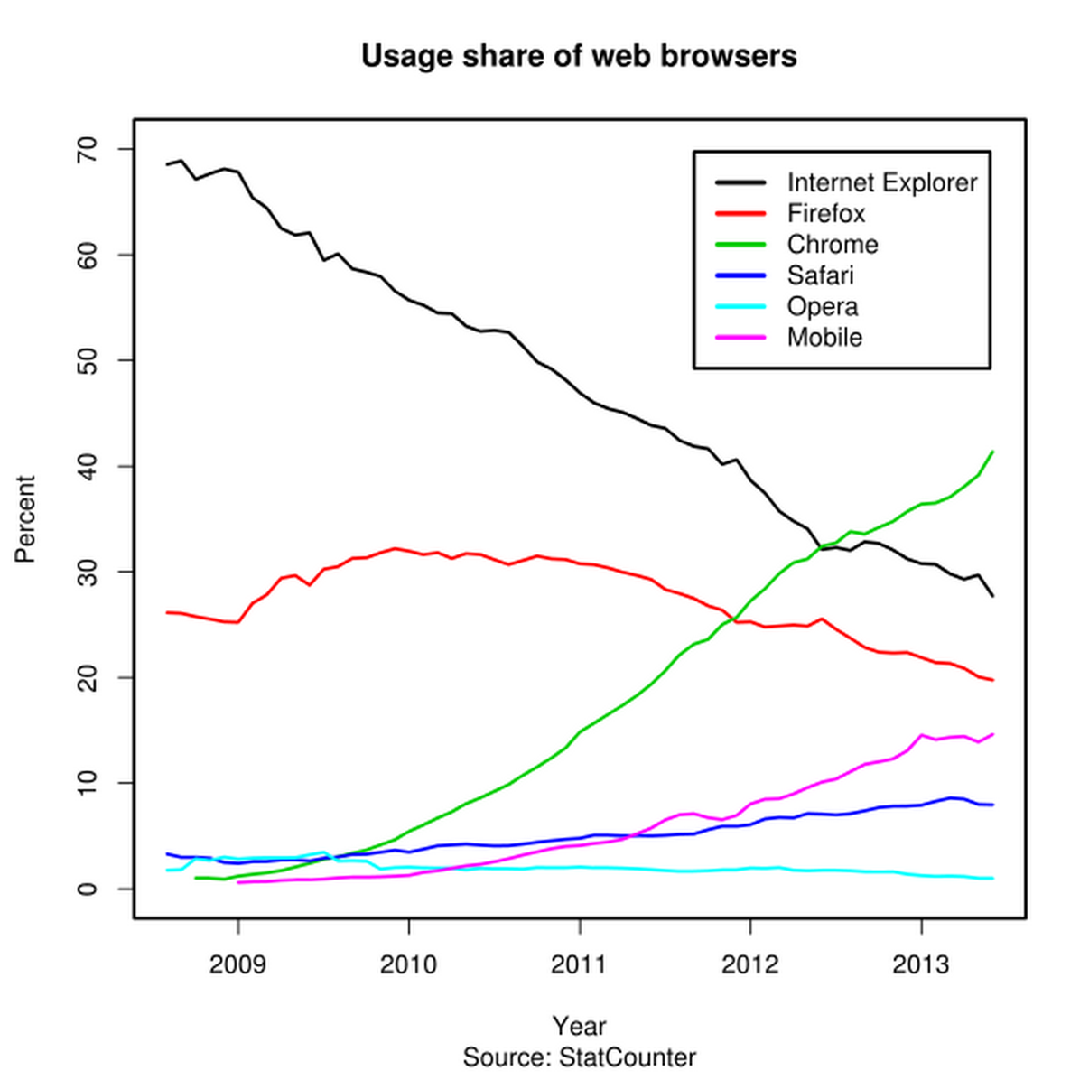
Browser Market Shares

Slide 11
Webkit: Chrome & Safari (+ Opera)
Chrome and Safari uses a rendering engine called WebKit.
Opera also switched to WebKit fairly recently.
Since they share the same engine, if you develop for Chrome, it will most likely work well on Safari.
Difference between Chrome and Safari is mostly in performance.

Slide 12
Mozilla Firefox
Firefox uses its own rendering engine called Gecko.
In terms of rendering HTML, Firefox does the same as Webkit browsers. (no need to worry!)
However, Firefox has its own rules for CSS:
(Webkit) –webkit-transition: linear 0.2s;
(Firefox) –moz-transition: linear 0.2s;
For Mac, Firefox does not have a transparent scrollbar.
Need to account for the width of a scrollbar for your div!

Slide 13
Internet Explorer (Oh-no!)
Internet Explorer causes the most of the browser compatibility issues.
IE 10 & IE 11
HTML rendering is usually the same as Webkit browsers.
Some issues with CSS3. Not all CSS3 properties are supported, but most are.
IE 9
HTML5 File & Drag and Drop API not supported
CSS3 3D effects and gradients, as well as media query not supported

Slide 14
Internet Explorer (Oh-no!)
Internet Explorer causes the most of the browser compatibility issues.
IE 8
SVG image file is not supported.
HTML5 & CSS3 not supported.
< IE 7
Lots of things go wrong.

Slide 15
Conditional comments
Microsoft knows IE has problems, so they provide developers with a feature called “Conditional comments.”
Conditional comments are blocks that execute only for a particular browser.
<!--[if IE 7]> Add code that will only execute for IE 7 <![endif]-->
Other examples
[if IE]: All Internet Explorer
[if lte IE 9]: Less than or equal to IE 9

Slide 16
Screen Resolutions
Not all users will view your web browser in the same screen resolution.
Ex.: 1280x800 (13” MBP), 1440x900 (15” MBP, 13” MBA)
Screen resolutions also come into play when you change the size of your window.
Every time you create a website, check how your website would look in smaller window sizes.

Slide 17
Screen Resolutions
Containers are very helpful for addressing screen resolutions
1024x768 container, centered: All users with screen resolutions higher than or equal to 1024x768 will be okay.
Generally, aim for 1024x768 as your minimum screen resolution.
But what about users with lower screen resolutions?

Slide 18
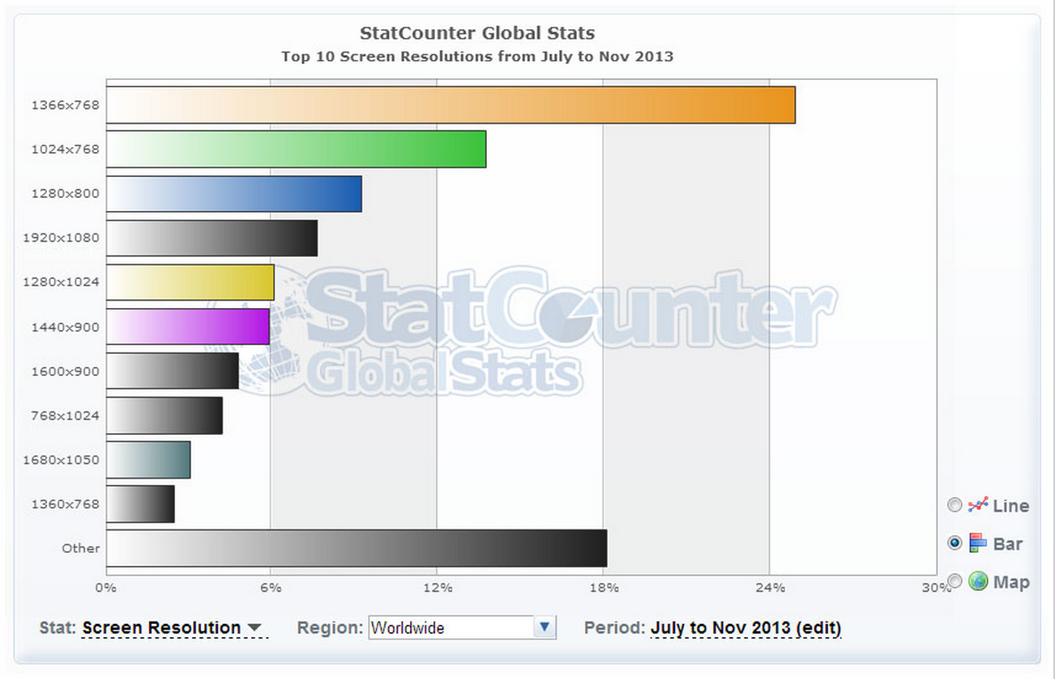
Most Popular Screen Resolutions

Slide 19
CSS Media Query
CSS Media Query allows you to use different stylesheets for different screen sizes.
@media (max-width: 1024px) { Add CSS code here }
For example, you can use display: none CSS property to hide certain elements when a user’s browser width is less than 1024px.
Generally, you cannot change your HTML for different browser width. You should change your CSS for different browser width instead!

Slide 20
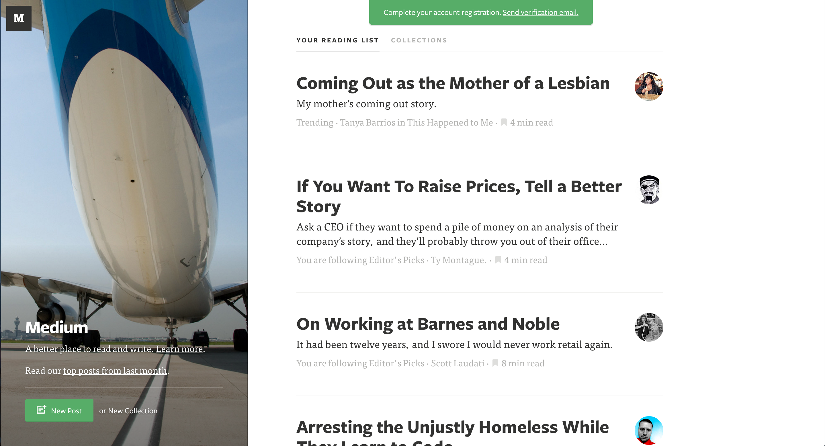
Medium: 1000 px <

Slide 21

Medium: 500 px < width < 1000px

Slide 22

Medium: < 500 px

Slide 23
Demo

Slide 24
Retina Display
Retina Display (or High-res display in general) is a screen with twice the pixels in the same screen resolution.
Your website layout does not change for devices with Retina Display, since the effective screen resolution does not change.
What changes are your icons and images
Ex.: If you set your image tag with width 200px and height 200px, the browser will render image to be 400px width and height for Retina Display.
To accommodate devices with Retina Display, your images need to be high-res, usually 2x the size.

Slide 25
Designing for Mobile
User Interface for mobile devices are quite different from those for desktop.
If designed well, HTML5 powered “websites” can be as useful as native applications.
Ex.: Naver
However, designing well for mobile devices is difficult and requires an entire class on its own.

Slide 26
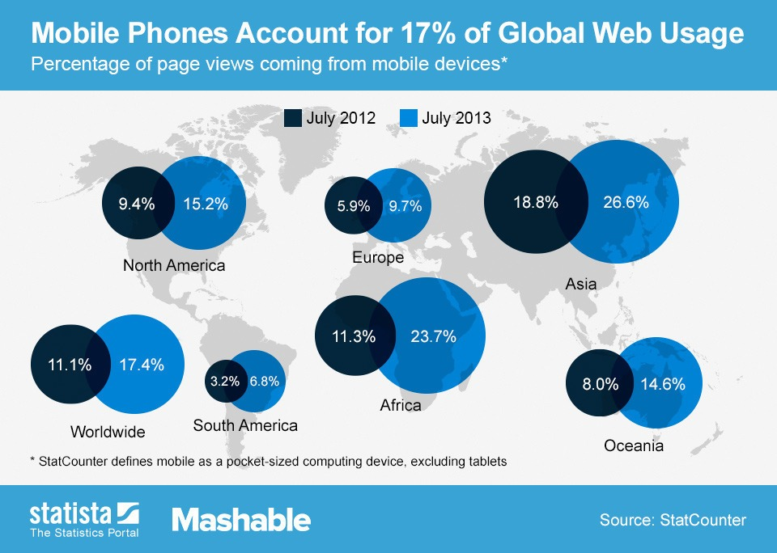
Mobile Internet Usage

Slide 27
Mobile vs. Desktop
Screen Size
Mobile: 3.5 ~ 5.5”
Desktop: 11” ~ 30”
Input Method
Mobile: Touchscreen
Desktop: Mouse or Trackpad
Performance
Desktop: 172.4ms (Sunspider)
Mobile: 395.9ms (Sunspider)

Slide 28
Issue 1: Screen Size
On a mobile device, screen size is much, much smaller than on a desktop device.
You really need to focus on the content and tuck in everything else away.
Position: fixed elements hurts on mobile.
You don’t have enough room to have a lot of position: fixed elements take up space on a small display
On a mobile devices, most elements stack vertically, full width.
Exception: Grid

Slide 29
Issue 2: Touchscreen
On a mobile device, you don’t have the precision of a mouse cursor for clicks
Buttons need to accommodate for the size of people’s thumb!
= You need more padding.
Each keyboard activity is a cost for the user
Try to minimize keyboard inputs – autocomplete very helpful.

Slide 30
Issue 3: Performance
Rendering performance on a mobile device is half that of desktop.
Try to minimize heavy front-end manipulation using Jquery.
Mobile browsers (Safari, Chrome) render differently compared to desktop browsers
As a result, mobile websites tend to be slow.
Try to reduce ajax calls and in-page manipulations
Use links instead.

Slide 31
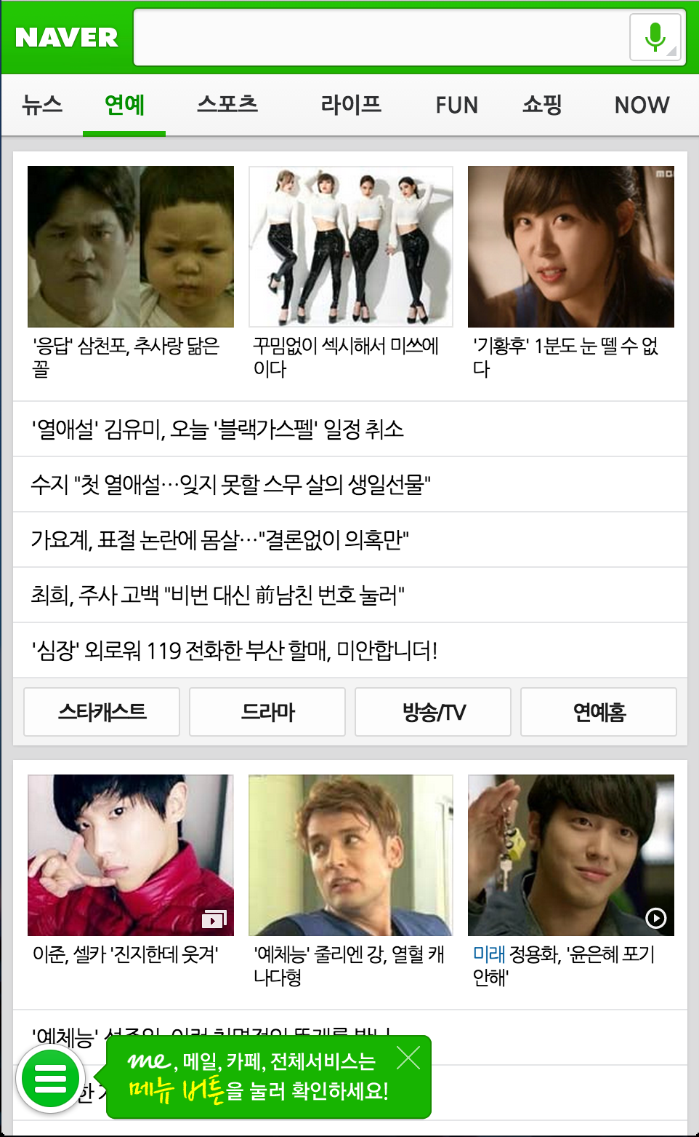
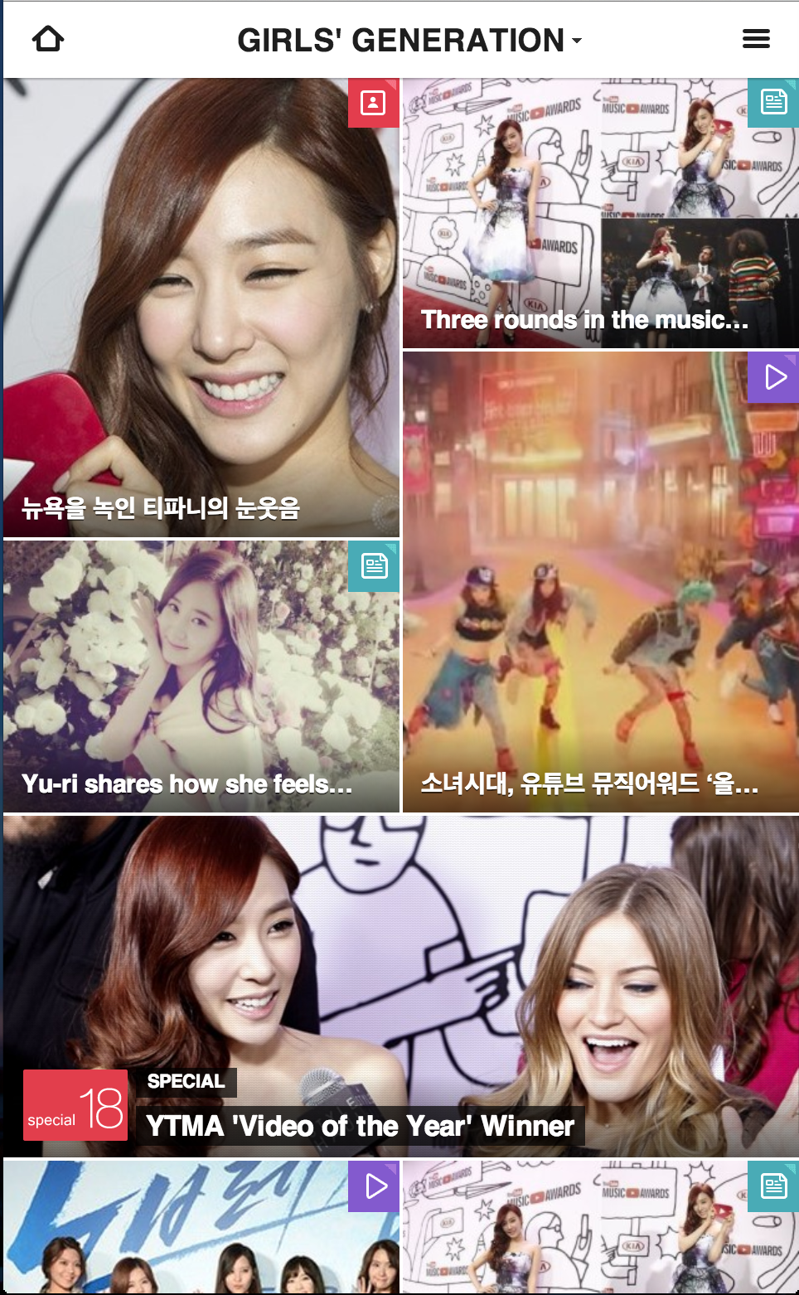
Mobile Webdesign: Naver

Slide 32
Review
Responsive Design
Browser Compatibility
Chrome & Safari -> Firefox -> IE
Screen Resolutions
1280x800 ~ 1440x900 most popular
Use CSS Media Queries
Mobile Web Design
Design for smaller screen size
Design for touchscreen
Design for lower performance

